Slide 1
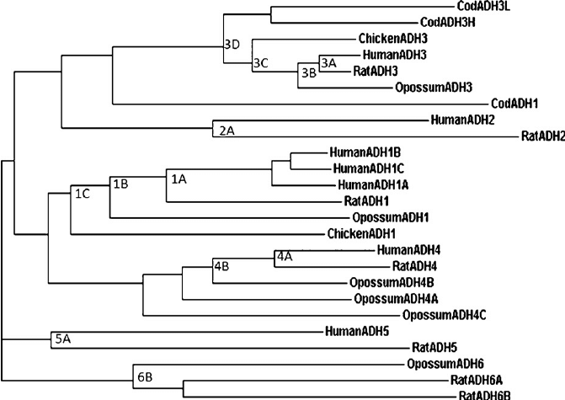
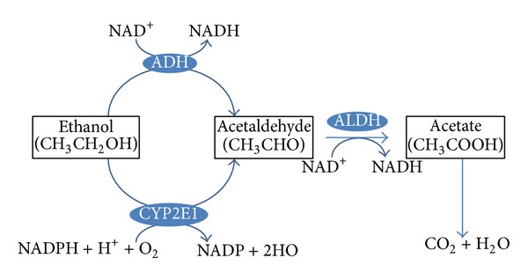
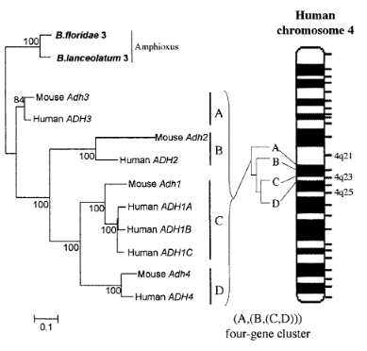
The Evolution of Alcohol Dehydrogenase Genes
Sherry Berumen, Camille Dana, Brandee Harmon, Jose Reyes, Jermiah Zumsteg
ADH1
What are Alcohol Dehydrogenase Genes?
ADH6
Location:
Chromosome 4 in humans, chimpanzees, and chickens
Chromosome 32 in dogs
Function:
Encodes for class I alcohol dehydrogenase 1 mostly in the liver
Catalyzes alcohols efficiently
ADH1A allele active during fetal development, but not in adulthood
ADH1B allele provides protection against alcoholism
Evolution:
Originated 450 MYA, in bony fish, by tandem duplication of class III ADH
Predates natural ethanol availability
Role in ethanol metabolism is thought to be secondary (not adaptive)
Primates have 3 copies (ADH1A, ADH1B, and ADH1C; see fig. 3), while bony fish have up to 5 and other mammals have only 1
Multiple independent gene duplications
According to molecular dating, origin of the ADH1B allele in Asian populations occurred about 10,000–7000 YA (Hernández-Tobías et al. 16)
8 alcohol dehydrogenase (ADH) genes are found in vertebrates, including primates, rodents, amphibians (see fig. 1)
Encode for 5 classes of enzymes (and one iron-containing enzyme) called alcohol dehydrogenases (HGNC)
Aid in detoxification via alcohol metabolism by converting alcohols into aldehydes, which are further broken down and eliminated from the body (see fig. 2)
Evolved as an adaptation for eating fermented food
Recent research indicates some classes originated before dietary ethanol was available
Ability to oxidize alcohol may be incidental (not a result of adaptation) (Hernández-Tobías et al. 14)
Location:
Chromosome 6 in cattle
Chromosome 4 in humans and chimpanzees
Chromosome 2 in rats
Function:
Encodes for class V alcohol dehydrogenase 6 in stomach and liver of placental mammals
Metabolizes ethanol, retinol, other aliphatic alcohols, hydroxysteroids, and lipid peroxidation products
Evolution:
Originated by means of a tandem duplication of class VI ADH
Distribution traces their origin to 100 MYA
Appearance of physiological role is still unknown
ADH7
ADH4
Location:
Chromosome 4 in humans
Chromosome 8 in pigs
Chromosome 1 in Xenopus
Function:
Encodes for class IV alcohol dehydrogenase 7 in stomach
Inefficient at catalyzing ethanol – only involved when ethanol concentrations are high
Efficient as a retinol dehydrogenase
Mechanisms governing the tissue specific expression remain unexplained
Evolution:
Origin can be traced to marsupials 176 MYA
Appearance of physiological role is still unknown
Location:
Chromosome 4 in humans and chimpanzees
Chromosome 3 in mice
Function:
Encodes for class II alcohol dehydrogenase 4
Metabolize ethanol, retinol, hydroxysteroids, and lipid peroxidation
Processes higher levels of ethanol than all other ADHs (NCBI)
High retinoid enzymatic activity (Reimers et al.3803) (Borras et al. 2)
Evolution:
Random mutation occurred in ADH1 during duplication 80 MYA
Human ancestors became less terrestrial and foraged the open plains
Adaptive and beneficial to avoid food poisoning
Passed on to offspring through natural selection (Choi)
ADHFE1
ADH5
Fig. 1. A phylogenetic tree of ADH genes in humans and other vertebrates from Roger S. Holmes, "Opossum Alcohol Dehydrogenases: Sequences, Structures, Phylogeny and Evolution“, Chemico-Biological Interactions vol. 178, no. 1-3, 2009, pp. 8-15, Research Gate, doi:10.1016/j.cbi.2008.09.009, 16 Nov. 2016.
Location:
Chromosome 2 in chickens and zebrafish
Chromosome 8 in humans, chimpanzees, macaques
Function:
Encodes hydroxyacid-oxoacid transhydrogenase in vertebrates
Catalyzes the oxidation of 4-hydroxybutyrate (Hernández-Tobías et al. 22)
In mammals, also encodes iron-containing alcohol dehydrogenase
Involvement in ethanol oxidation is negligible and not fully understood (Hernández-Tobías et al. 16)
Evolution:
Phylogenetic analyses indicate it appeared
Before angiosperms and land plants
Before the divergence of fungi and animals
Independently of dietary ethanol
Role in ethanol metabolism is thought to be secondary (not adaptive)
Single-copy gene (Hernández-Tobías et al. 14)
Location:
Chromosome 4 in humans and chimpanzees
Chromosome 14 in zebra fish
Chromosome 6 in cattle and 2 in rat (NCBI)
Function:
Encodes for class III alcohol dehydrogenase 5 in esophagus, intestines, liver, and stomach (GNC) (HAMS)
Ethanol oxidation is negligible
Efficient at oxidation of long-chain primary alcohols (Reimers 38303)
Efficient at oxidation of formaldehyde via cellular metabolism (Edenberg)
Evolution:
Less than 310 MYA. cephalochordates <580 MYA and vertebrates 505 MYA existed (Reimers, Hahn, and Taguay 38309)
Fig. 2. The pathway of ethanol metabolism from Hideto Kawaratani, et al., “The Effect of Inflammatory Cytokines in Alcoholic Liver Disease”, Mediators of Inflammation, 2013, PubMed, doi:10.1155/2013/495156, 17 Nov. 2016.
Fig. 3. A phylogenetic tree of various ADH genes and their relative location on Human chromosome 4 from ____________

